Slide 1
WELCOME SYLVAN HILLS MIDDLE GO TEAM MEETING

Slide 2
Today’s Agenda
Call to Order
Norms
Roll Call
Action Items
Approval of Agenda
Approval of Previous Minutes
FY23 Budget Approval
Information Items/ Announcements
Principal Report
Adjournment

Slide 3
Let’s commit to:
Wearing masks and socially distancing
Being present and engaging meaningfully so that we can learn from each other (i.e. Cameras on)
Refrain from using electronic devices unless required to engage in the work
Muting your microphone (VIRTUAL) and minimizing extraneous conversations
Assuming good will
Allowing all voices of the team to be heard
Focusing on the day’s content
Starting and ending on time
Being gracious

Slide 4
GO TEAM MEMBERS 21-22
NAME | ROLE
Ms. Monica Blasingame | Principal
Ms. Jessica Bracey | Parent
Ms. Queen Rosa Harden-Green | Parent
Ms. Kinisha Banks | Parent
Ms. Sade Miller | Staff
Ms. Alexandria Gonsalves | Staff
Kevin Rhodes | Staff
Ms. Keisha Mackey | Community Member
Ms. Johnetta Johnson | Community Member
Ms. Natasha Jewell | Swing Seat

Slide 5
Action Items
.
Action Items
Approval of Agenda
Approval of Previous Minutes
FY23 Budget Approval

Slide 6
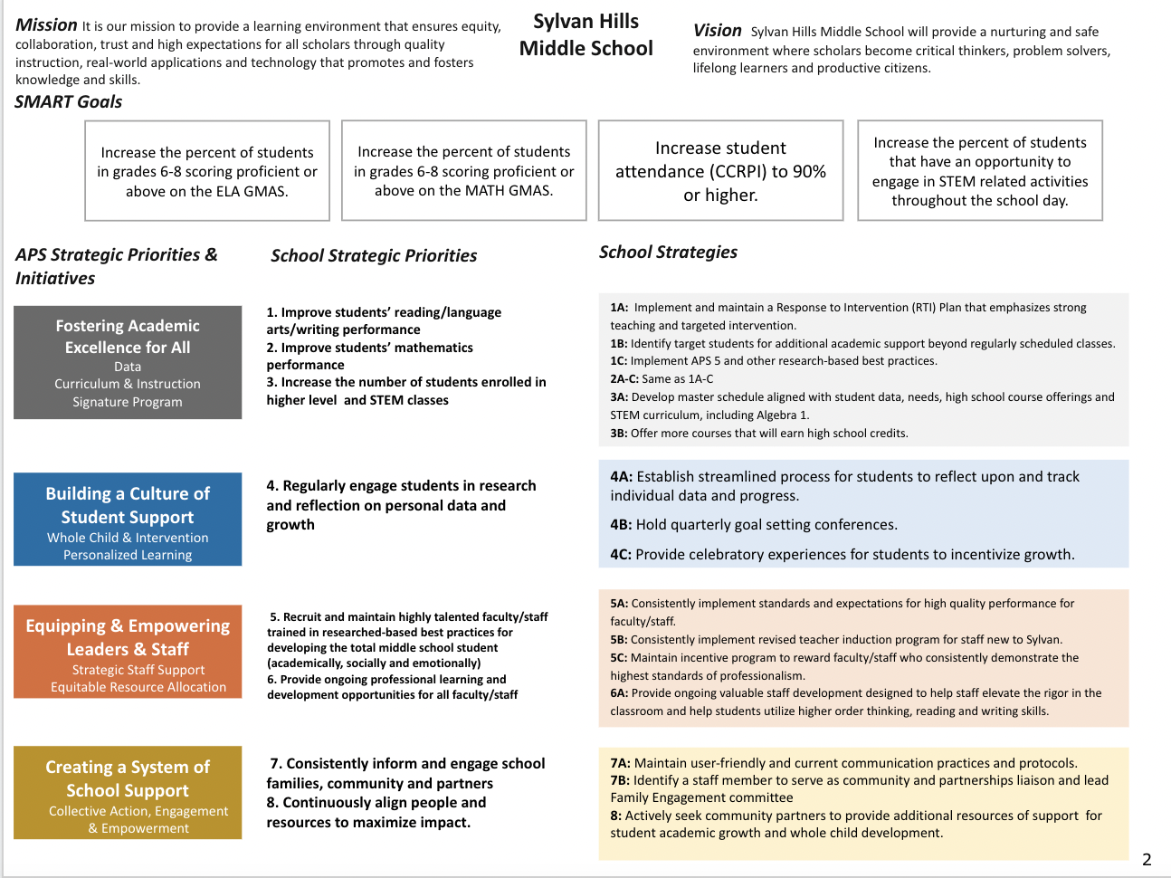
Sylvan Hills Strategic Plan
Notes:
You should have a copy of our updated strategic plan (please make copies to be distributed to team).

Slide 7
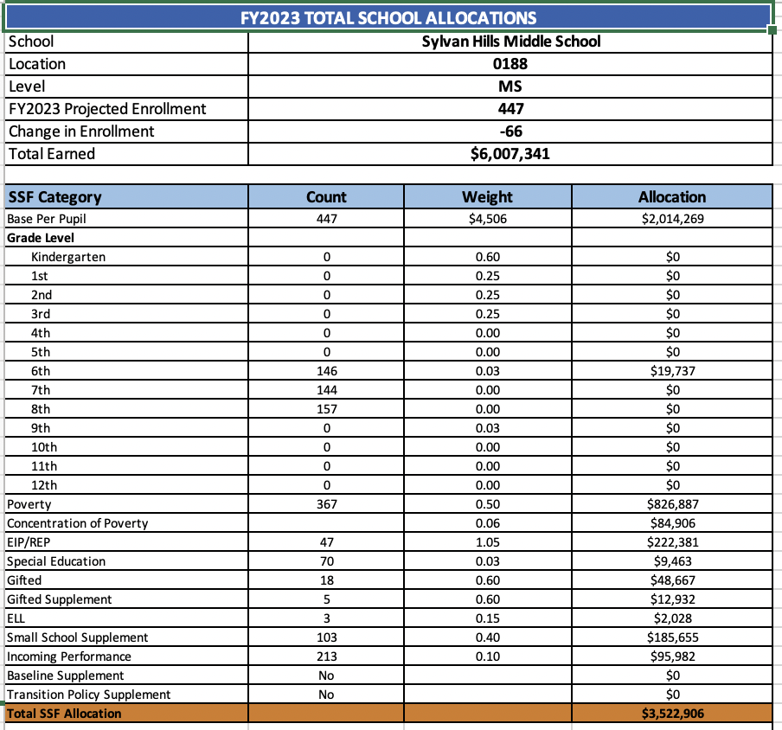
School Allocation
Notes:
d- $330,543
For FY23, APS is continuing to increase equity within the District and the flexibility principals have in regards to our schools budgeted funds. The new Student Success Funding Model (SSF) allocates dollars to schools based on the number of enrolled students and receives a funding "weight" based on need. This year, student characteristics were weighted based on:
Grade Level –
K-12
Poverty – Weighted for all Direct Certification enrolled students.
Beginning Performance – Weighted Middle School and High School students entering with beginner’s performance on milestones.
ESOL – Weighted for all ESOL designated students in order to supplement due to ESOL staff being locked.
Special Education - Weighted for all Special Education students.
Gifted – Weighted and measured by number of students in the Gifted Program
Small School Supplement – Weighted for low enrollment schools
ES – 500
MS – 600
HS – 700
As you can see, our projected enrollment for FY23 is _______, we increased/decreased by __________ from last year.
We received the following weights for our student characteristics: (Below is just for the script, principals need to insert their school’s characteristics)
Grade Level
Poverty
Special Education
Gifted
Gifted Supplement
ELL
Small School Supplement

Slide 8
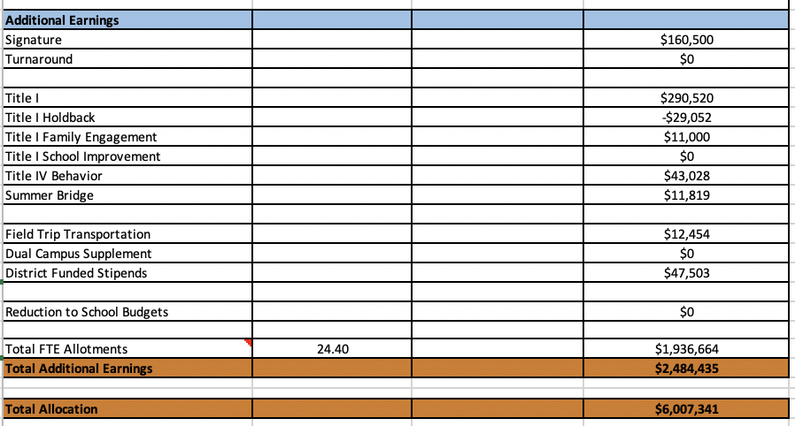
School Allocation
Notes:
Additionally, we received money for signature programming, turnaround, Title I and FTE Allotments.

Slide 9
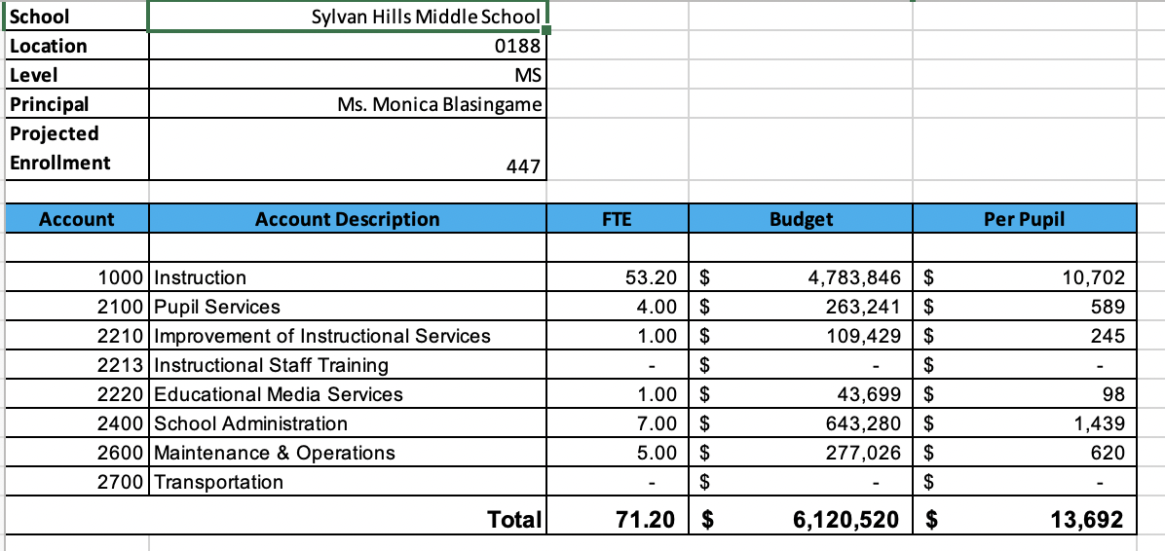
Budget by Function
Notes:
I am passing out the definitions for these funding categories. You will see what makes up each category. Although the school’s total budget amount will not change, allocation per function may change depending on our conversations and school needs.

Slide 10
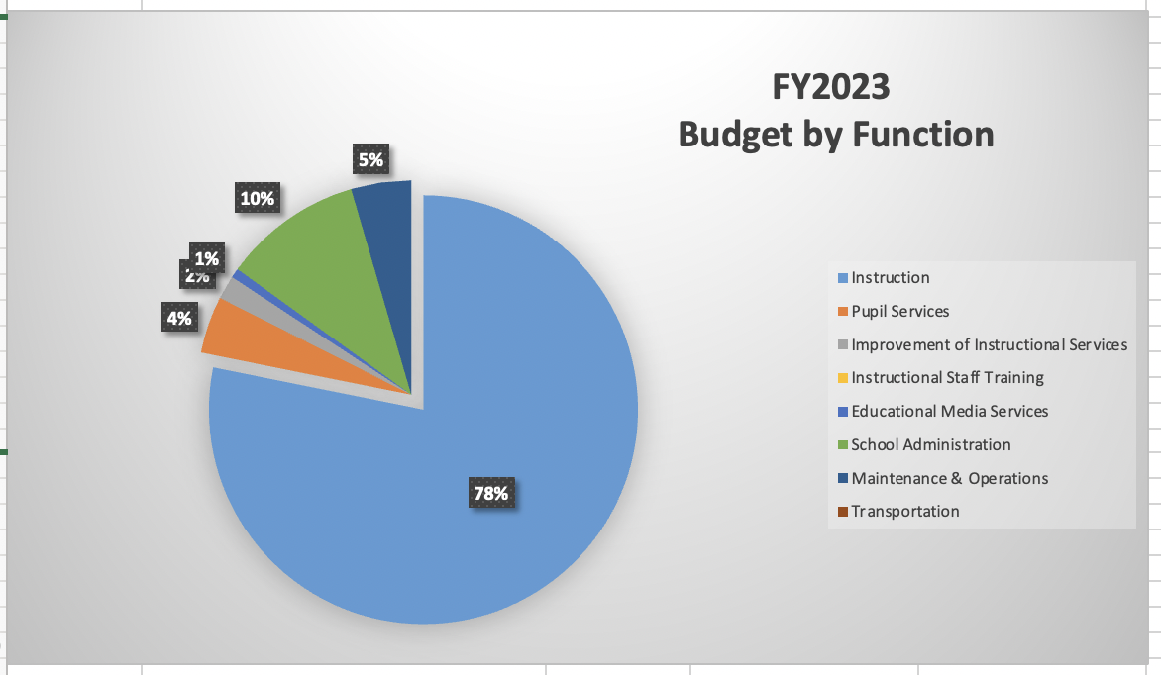
Budget by Function
Notes:
Explain the pie chart and allocations

Slide 11
CARES Allocations
Other allowable CARES expenditures include:
Technology Support: Software, assistive technology, online learning platforms, subscriptions.
Mental and Physical Health: Cover the costs of additional counseling, telehealth, therapeutic services, and wraparound services and supports (contracted hours, professional learning, programs)
Supplemental Learning: Cover costs of remediation, and/or enrichment opportunities during the school year for students (afterschool programs, additional pay for teachers and staff, transportation).
Professional Development: Cover costs of additional professional development for school leaders, teachers, and staff (trainings, extended professional development days, consultants, programs).
At-risk Student Populations: Cover costs of school specific activities, services, supports, programs, and/or targeted interventions directly addressing the needs of low-income students, students with disabilities, racial and ethnic minorities, English Learners, migrant students, students experiencing homelessness, and children in foster care.
Continuity of Core Staff and Services. Restore any potential LEA FY22 budget reductions due to decreased state and/or local revenue.

Slide 12
School FY23 CARES Allocation
FY23 CARES II Allocation | 211,261
FY 22 CARES II Remaining Balance | 190,876
In addition to a General Fund allocation, our school has been allocated CARES funding that must be used to support implementation of the school-based intervention block and other school-based needs as a result of the COVID-19 Pandemic.
Once the support needed to implement our school-based intervention block/course has been fulfilled, we can use the remaining CARES funds to address other school-based needs that are a result of the COVID-19 Pandemic.
Notes:
Please add your school’s CARES Allocation to this slide.

Slide 13
Executive Summary
This budget represents an investment plan for our school’s students, employees and the community as a whole.
The budget recommendations are tied directly to the school’s strategic vision and direction.
The proposed budget for the general operations of the school are reflected at $6,007,341
This investment plan for FY23 accommodates a student population that is projected to be 447 students, which is a decrease of 66 students from FY22.
Notes:
Here’s a few highlights for our budget this year – read executive summary

Slide 14
Draft of Considerations
Changes in Standards of Service and/ or Funding Sources:
(1) Full-Time Media Specialist change in Standards of Service
(1) School Social Worker change in funding source
(1) School Nurse change in funding source
(1) Non-Instructional Aid
Recommendation to abolish the following positons
Media Paraprofessional Position
Reading Intervention Position

Slide 15
What’s Next?
Final Budget Approval

Slide 16
ANNOUNCEMENTS!
National School Social Workers Week March 7th – 11th
Teacher Work Day: March. 21st
MAP Administration

Slide 17
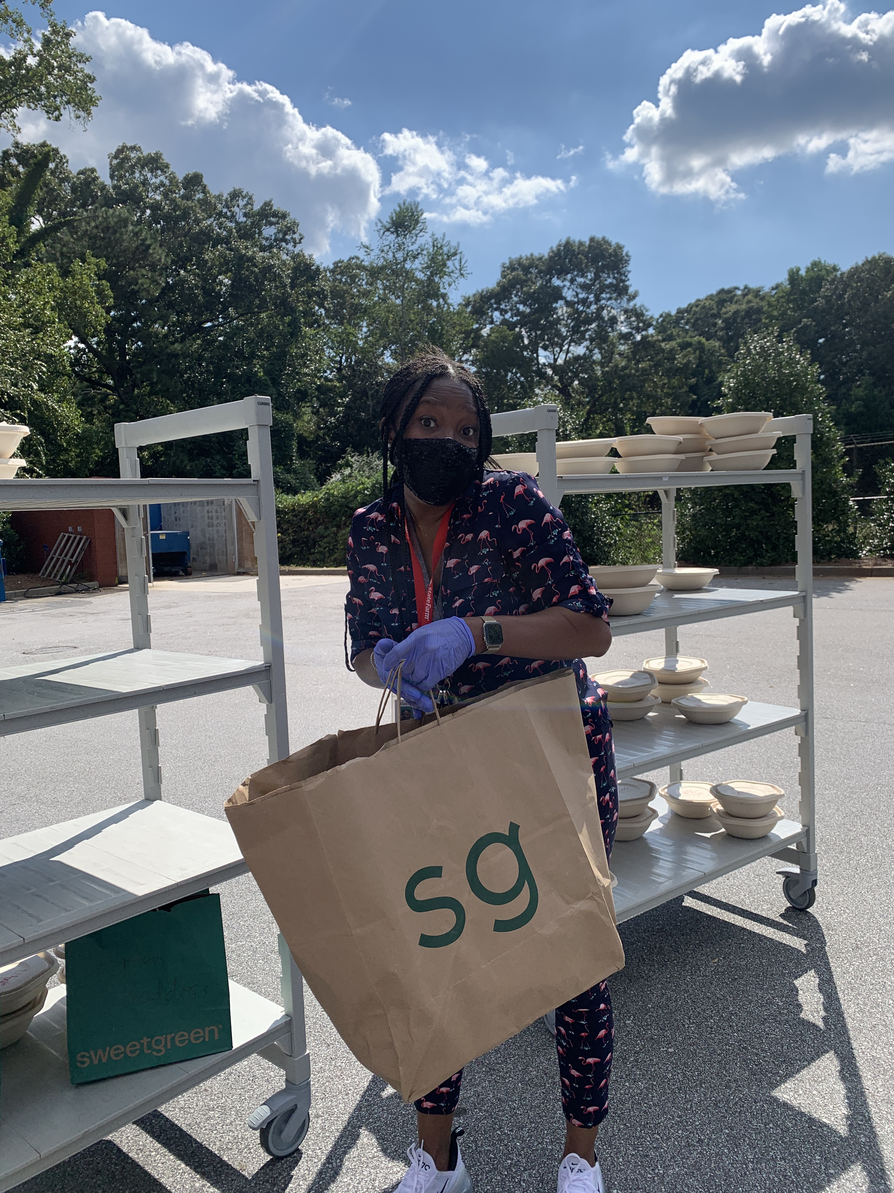
Happy National School Social Worker Week!

Slide 18
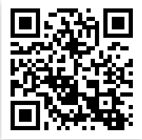
Connect with US!
@apssylvanhillsms
https://www.atlantapublicschools.us/Page/4020
@apssylvanhills

Slide 19
Questions?
Feedback?
Concerns?

